Slide 1
Detection of Phishing Website using Machine Learning Model based URL Analysis
Week- 4 & 5 : Data Visualization and Initial Feature Extraction
Priyanka Patil

Slide 2

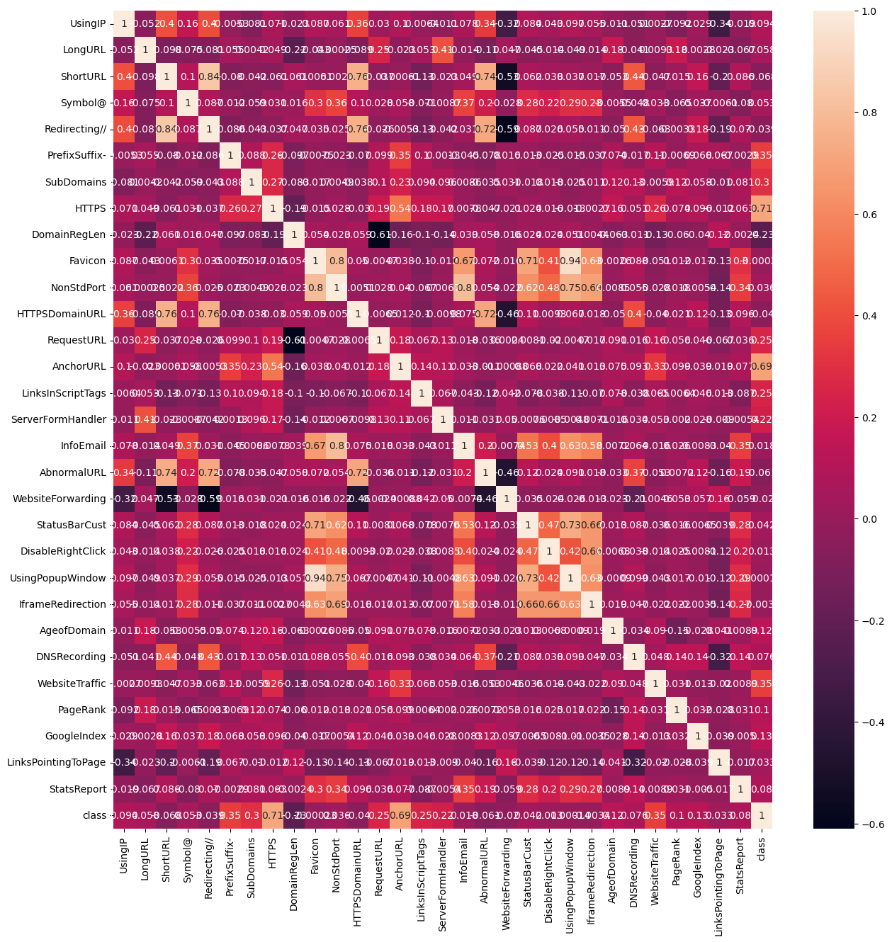



Data Visualization: Few Graphs have been plotted to show the relation between the features in the data set.
Correlation Heatmap

Slide 3
A correlation heatmap is a graphical representation of a correlation matrix, which in turn is a table showing correlation coefficients between variables. Each cell in the table shows the correlation between two variables. The heatmap encodes the values of these coefficients with color, providing an easy-to-read visual summary of how each variable is related to the others.
Purpose - The primary purpose of a correlation heatmap is to show pairwise correlations between variables. It's particularly useful when we have several variables and need to understand the inter-relationships among them at a glance.
Representation - Each cell in the heatmap shows the correlation coefficient between two variables, represented by the intersecting row and column. The color and the number within each cell represent the strength and direction of the correlation:
Positive Correlation: If the coefficient is close to 1, it is shaded with a stronger intensity of one color (pink /red), indicating a strong positive correlation.
Negative Correlation: If the coefficient is close to -1, it is shaded differently (blue/black), showing a strong negative correlation.
No Correlation: A coefficient close to 0 indicates no linear relationship, and these cells are usually shaded neutrally.
Diagonal: Coefficients of 1 down the diagonal where each feature correlates perfectly with itself.

Slide 4
INTERPRETATION OF THE GRAPH COLORS:
High Positive Correlation (Dark Reds): If two features like LongURL and UsingIP have a dark red square between them, this may suggest that phishing URLs tend to both be longer and use IP addresses rather than domain names. A high positive correlation between these features means that when one feature is present (e.g., a URL is long), the other is also likely to be present (e.g., the URL uses an IP address).
Low or No Correlation (Whites): If there’s a feature like HTTPS that has a white square in relation to Favicon, this means there’s little to no linear relationship between them. In practice, whether a URL uses HTTPS or not is independent of the favicon's properties.
High Negative Correlation (Dark Blues): If a feature such as AgeofDomain has a dark blue square with the class label, it could imply that newer domains (lower AgeofDomain) are more commonly associated with phishing (class label indicating phishing), while older domains are less likely to be phishing sites.

Slide 5
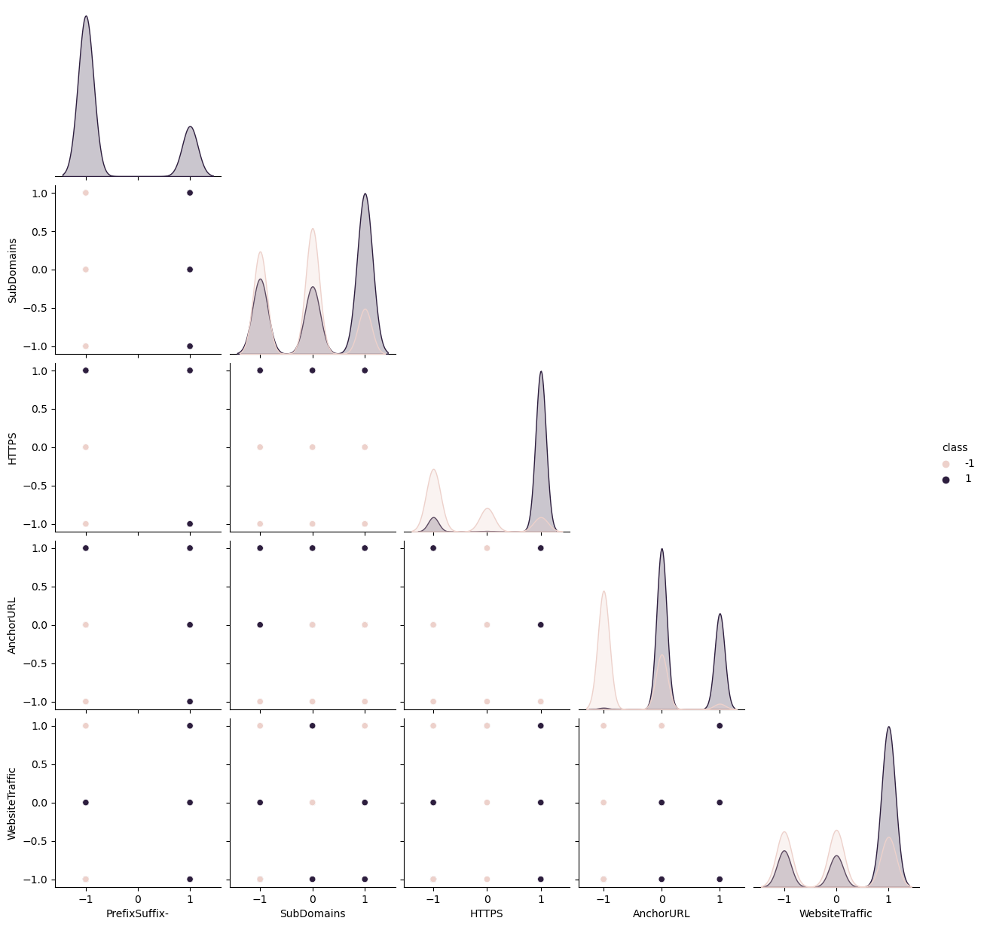
PAIRPLOT FOR PARTICULAR FEATURES

Slide 6
A pair plot is a matrix of scatterplots that allows you to see both the distribution of single variables and relationships between two variables
What is a Pair Plot?
Diagonal: The diagonal of a pair plot typically shows the distribution of the dataset's individual variables, often as histograms or kernel density estimates.
Off-Diagonal: The off-diagonal plots are scatterplots of the variable on the x-axis against the variable on the y-axis. These plots can show the relationship (correlation or patterns) between the two variables.
Why is it Used?
Visualization of Relationships: Pair plots are used to quickly visualize the relationships between all pairs of quantitative variables in a dataset.
Detect Patterns: They can help detect if any pairs of variables are correlated, if there are potential clusters in the data, or if any outliers exist.
Comparing Variable Distributions: The diagonal plots help compare how different variables are distributed.

Slide 7
SIGNIFICANCE:
Exploring Feature Interactions: For your phishing URL detection project, pair plots enable you to see how different URL features relate to each other. For example, you might see if longer URLs tend to have more subdomains or if HTTPS usage correlates with certain patterns in anchor URLs.
Class Separation: If you color the points by the class label (phishing, suspicious, legitimate), as it seems to be in your graph, you can observe how well-separated the classes are based on the features. If the colors form distinct clusters, it suggests that the features could be good predictors for classifying URLs.
Guiding Feature Engineering: Insights from pair plots can guide feature engineering. For example, if you notice that phishing URLs have a certain pattern of subdomains and HTTPS usage, you might create a feature that captures this interaction.

Slide 8

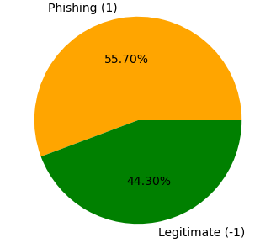
CLASS DISTRIBUTION IN DATASET

Slide 9
The pie chart provided illustrates the class distribution within my dataset, distinguishing between phishing (1) and legitimate (-1) websites. The chart shows a relatively balanced distribution because because neither class is significantly underrepresented; the two classes are within about 10 percentage points of each other.
Having a balanced dataset is crucial for training machine learning models because:
It helps ensure that the model does not become biased toward the more common class.
It improves the reliability of accuracy as a metric for model performance.
It allows for better generalization of the model when predicting new, unseen data.

Slide 10
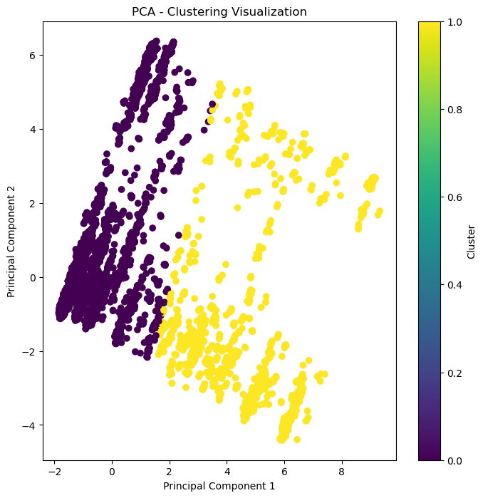
PCA – CLUSTERING VISUALIZATION

Slide 11
PCA is a dimensionality reduction technique that transforms the data into a new coordinate system with the axes called principal components (PCs).
These components are ordered such that the first principal component captures the maximum variance in the data, the second captures the second-most, and so on.
In this plot, only the first two principal components are visualized, which typically capture the most significant patterns in the data.
Clusters:
The different colors in the plot represent different clusters found in the data. A clustering algorithm like KMeans used to partition the data points into these clusters based on their similarity.

Slide 12
Principal Component Axes:
The horizontal axis (Principal Component 1) and the vertical axis (Principal Component 2) show the scores of each data point on these components.
The origin (0,0) in the plot is the mean of the dataset along each principal component.
Interpretation of Patterns:
Data points that are close together in the PCA plot are similar to each other in terms of their original features, while points that are far apart are more dissimilar.
Clusters of points indicate groups of URLs with similar features that could correspond to either phishing or legitimate websites.

Slide 13
Feature Relationships: The visualization suggests how features related to websites might be associated with each other after reducing dimensionality, helping identify features that are most indicative of phishing versus legitimate websites.
Model Insights: This plot can give insights into how well the PCA-transformed features might separate different classes of websites, which is valuable for building a predictive model.
Cluster Analysis: Analyzing the clusters can help understand the characteristics that differentiate between different types of websites, such as those that are clearly legitimate, clearly phishing, or potentially suspicious

Slide 14
NOTE:
PCA is an unsupervised technique and does not use class labels for the dimensionality reduction. The clusters are identified post-PCA based on the proximity of points in the reduced feature space.

Slide 15
WEEK 5 TARGET - INITIAL FEATURE EXTRACTION: (STARTED)
FEATURE.PY FILE HAS BEEN PUT INTO THE GIT REPOSITRY.
TO BE CONTINUED.......

